Slide 1
Classification, Reserve & RQO determination of water resources in the Mvoti to Umzimkulu Water Management Area
RIVER IUAS AND DRAFT WRC
Delana Louw
Rivers for Africa
16 Sept 2015
PRESENTATION TITLE
Presented by:
Name Surname
Directorate
Date

Slide 2
WRC and CATCHMENT CONFIGURATION
Using maps and the colour coding, provide the WRC for each IUA.
For each IUA provide a summary of the interventions required to achieve the Class and Ecological Categories for the catchment configuration.
These interventions basically provide the implications of the WRC and catchment configuration.
WRC I
WRC II
WRC III

Slide 3
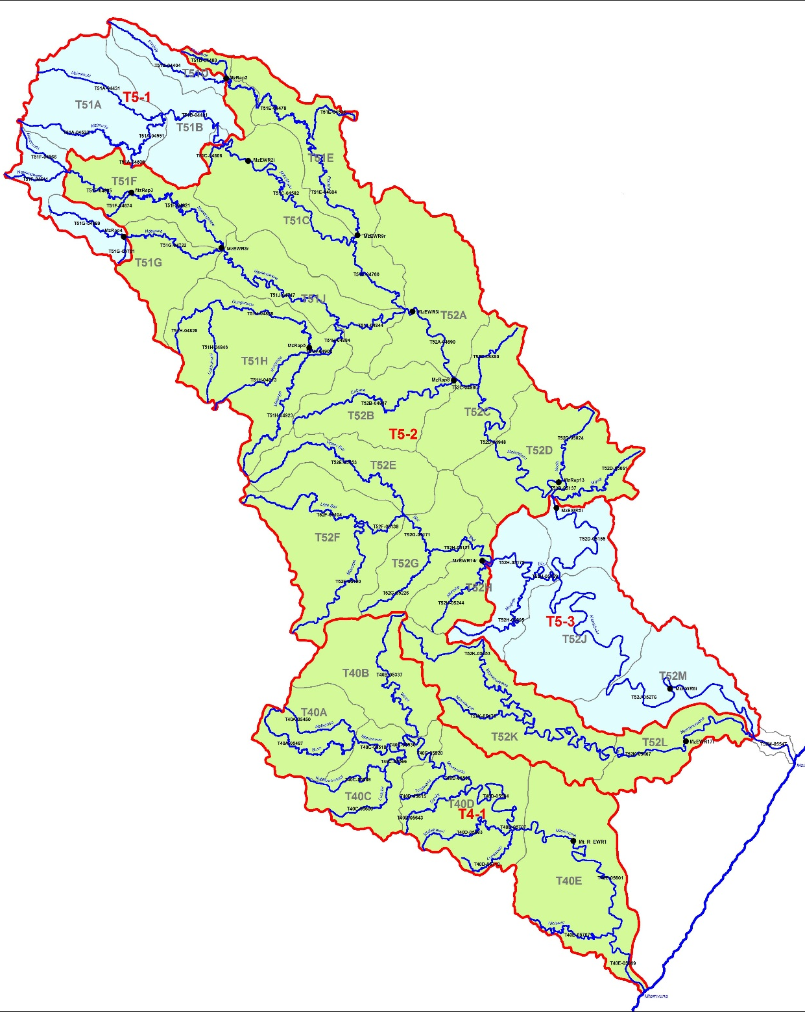
DRAFT WRC: T4 (Mtamvuna) & T5 (Umzimkulu)
WRC I IUA T5-1
No direct impact on users/economy and ecology
WRC I
WRC II IUA T5-2
No direct impact on users/economy. Six SQs require improvement, mostly related to catchment management and maintaining the riparian buffer.
WRC II
WRC III
WRC I IUA T5-3
No direct impact on users/economy and ecology
WRC II UA T4-1
Goze, Mtamvuna, Hlolweni B/C→B | Nonflow related: Catchment management of informal agriculture (overgrazing), removal of alien vegetation.
No direct impact on users/economy

Slide 4
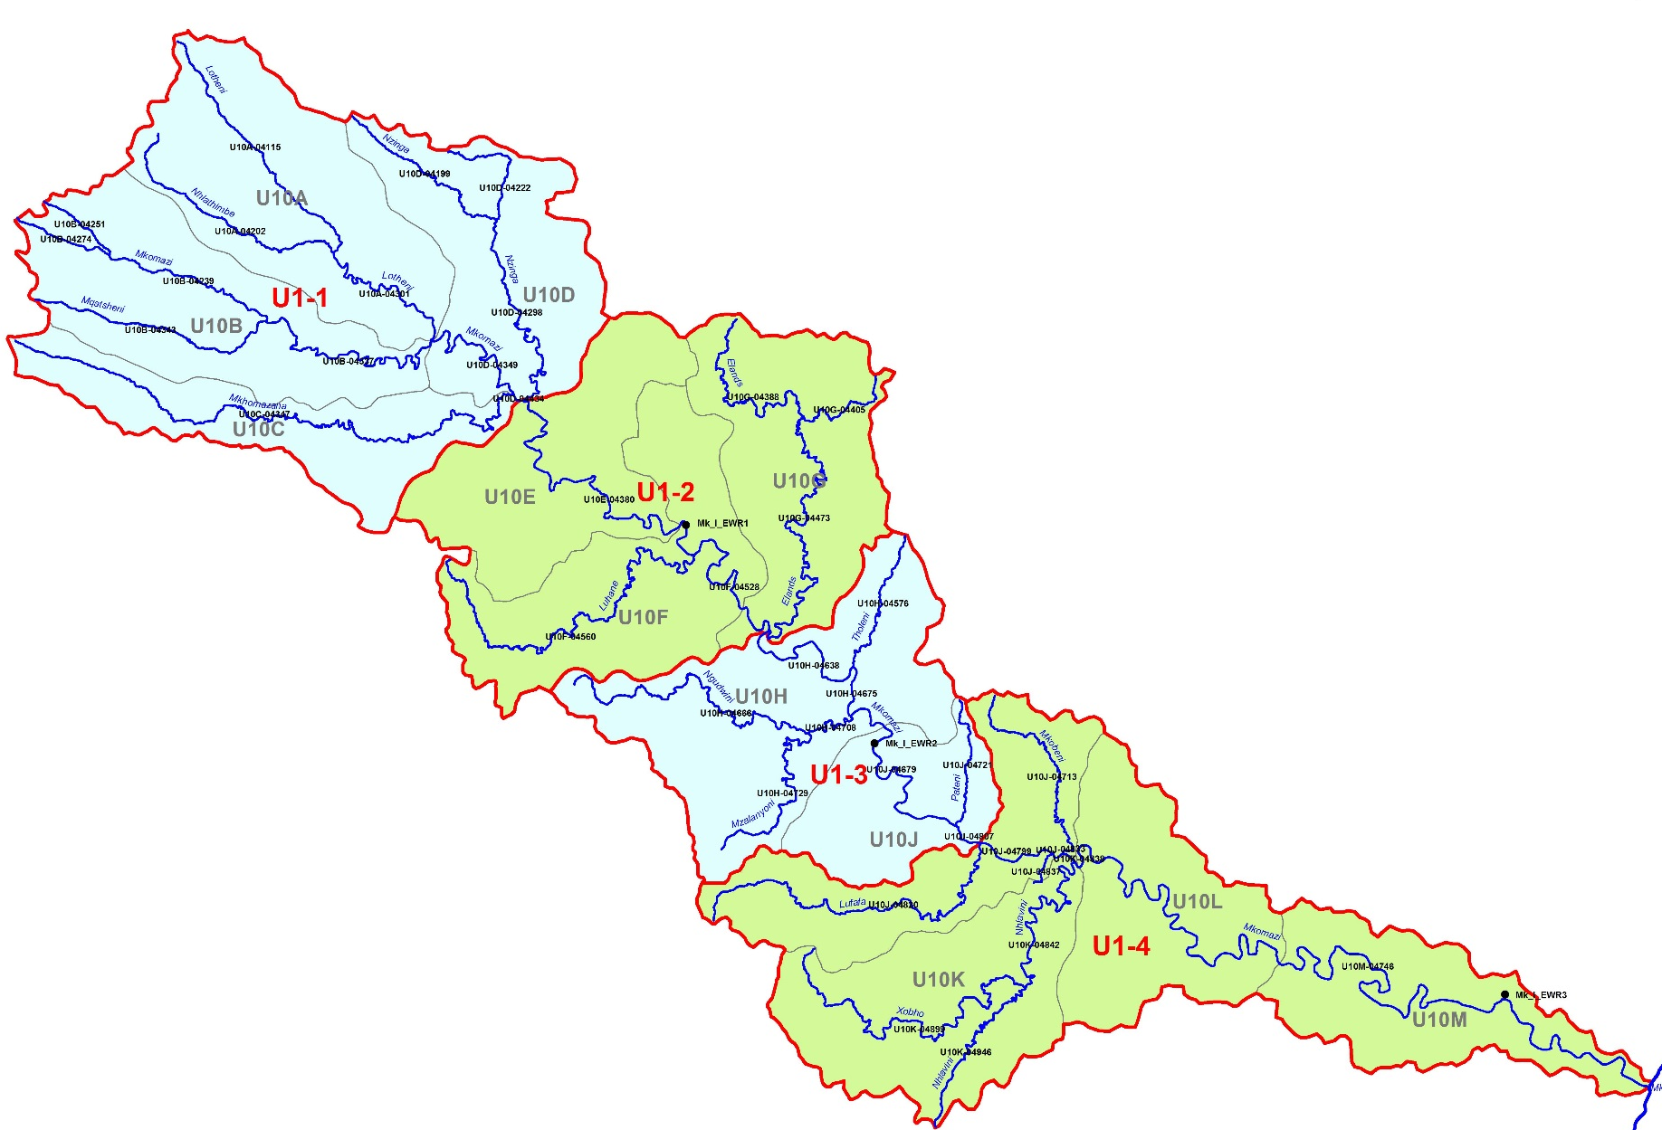
DRAFT WRC: U1, uMKHOMAZI RIVER SYSTEM
WRC I; IUA U1-1
Nzinga, uMkhomazi B/C→B | Catchment management to eg manage sedimentation.
No direct impact on users/economy
WRC II; (SC MK 21 II) IUA U1-2
Elands C→B | Buffer zone protection, alien veg removal.
Sc MK 21 negative implications for ecology (PES (REC) not maintained)
WRC II; (SC MK 21 II) IUA U1-4
Sc MK 21: Geomorph, Fish, Invert PES and REC will not be maintained.
WRC I; (SC MK 21 I) IUA U1-3
Sc MK 21: Geomorph, Fish, Invert PES and REC will not be maintained.
WRC I
WRC II
WRC III

Slide 5
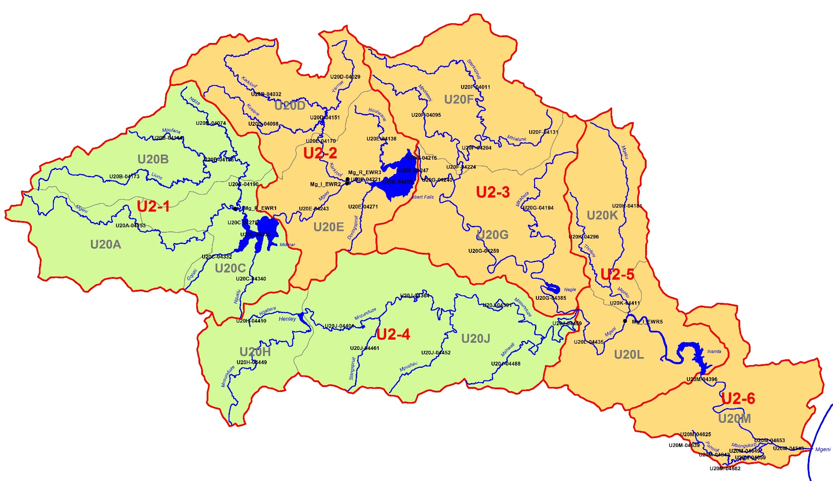
DRAFT WRC FOR U2, uMngeni RIVER SYSTEM
WRC III IUA U2-2
Karkloof, Yarrow: B/C→B | Riparian buffer
No direct impact on users/economy
WRC III IUA U2-3
No direct impact on users/economy and ecology
WRC I
WRC III IUA U2-5
Mzeku B/C→B | Riparian buffer
No direct impact on users/economy
WRC II
WRC III
WRC II IUA U2-1
Ndiza, Lions, Gzishi: B/C & C→B | Riparian zone reinstatement
No direct impact on users/economy
WRC II IUA U2-4
Mpushini, Mshwati, uMnsunduze | Water quality, riparian zone
Water quality improvements. uMnsunduze: Nutrient loading from Darvill WWTW, catchment runoff, highly polluted Baynespruit. Toxics, E. coli.
WRC III IUA U2-6
No direct impact on users, economy, ecology (only relevant for one trib – NOT for Umngeni River)

Slide 6
DRAFT WRC: U3, uMDLOTI RIVER SYSTEM
WRC II IUA U3-3
Mona B/C→B | Buffer zone protection,
No implications
WRC I
WRC II
WRC III
WRC III IUA U3-1
Mdloti, Mwangala C→B | Buffer zone protection, erosion control
No implications
WRC II IUA U3-2
No implications

Slide 7
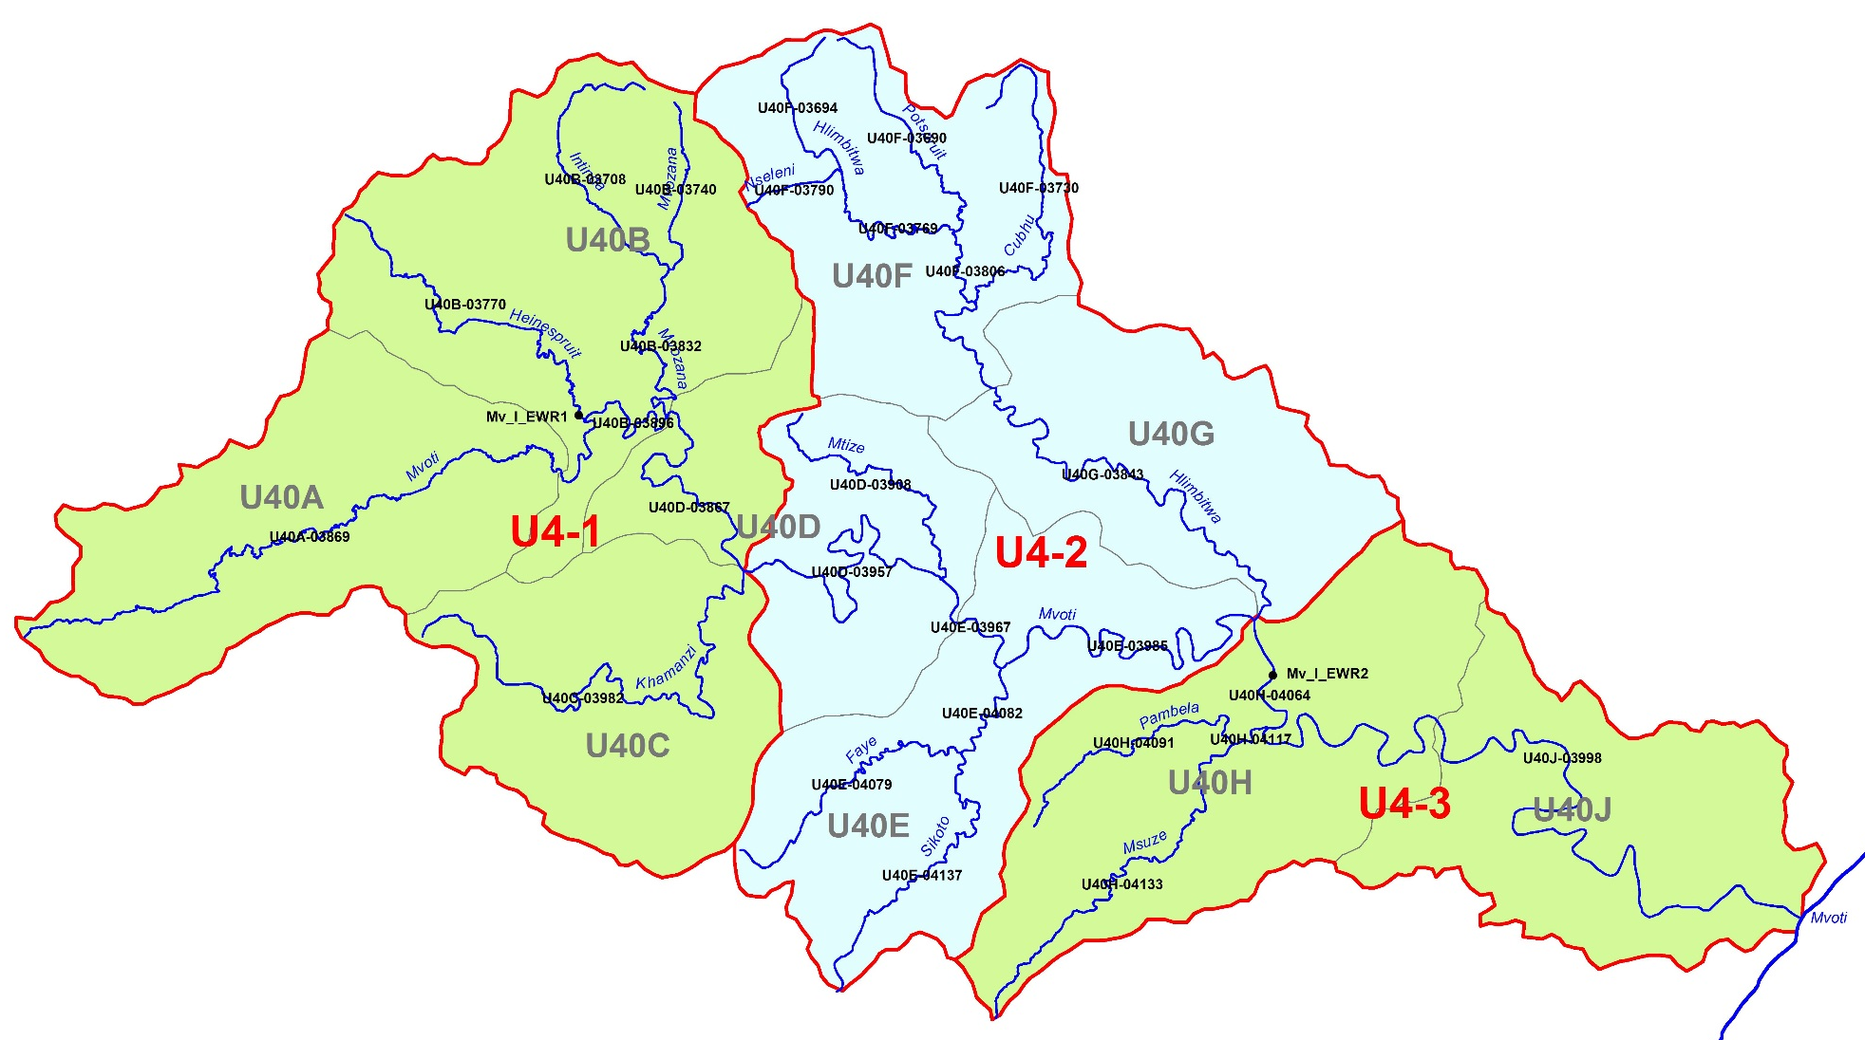
DRAFT WRC: U4, MVOTI RIVER SYSTEM
WRC I IUA U4-2
No implications
WRC I
WRC II
WRC III
WRC II IUA U4-1
Mvoti, Khamanzi B/C→B | Buffer zone protection (forestry & agriculture)
No implications
WRC II IUA U4-3
Pambela, Nsuze B/C→B | Buffer zone protection,
Under Sc 42: Geom, Fish REC will not be maintained. (Dam in place)

Slide 8
DRAFT WRC: U6, uMLAZI etc & U7, Lovu
WRC III IUA U6-1
No No implications
WRC III IUA U6-2
No implications
WRC I
WRC II
WRC III
WRC III IUA U7-1
No implications
WRC I IUA U6-3
Bivane B/C→B | Buffer zone protection, erosion control
No implications

Slide 9
DRAFT WRC: U8, uMLAZI etc RIVER SYSTEMS
WRC II IUA U8-2
Mtwalume, uMgeni B/C→B | Buffer zone protection, Return flows
No implications
WRC I
WRC II
WRC III
WRC I IUA U8-1
No implications

Slide 10
QUESTIONS FOR CLARIFICATION

